Slide 1
Module 3.1 / Week 5
Assessing inherent risk and other specific business risks

Slide 2
Learning Objectives
5.1 Explain the factors that influence the assessment of inherent risk.
5.2 Explain the auditor’s consideration of the risk of fraud.
5.3 Explain the auditor’s consideration of related parties.
5.4 Explain the auditor’s consideration of the appropriateness of the going concern basis.

Slide 3
LO 5.1
Inherent risk

Slide 4
Defining and Assessing Inherent Risk
  As discussed Risk of Material Misstatement at the assertion level consists of two components: inherent risk and control risk.
ASA 315/ISA 315 requires the auditor to identify and assess risk of material misstatement at both the financial report and assertion levels.
Inherent risk (IR):
  Susceptibility of account balance, class of transactions or disclosure to material misstatement given inherent and environmental characteristics, but without regard to internal control.
an auditor is required to:
                Assess IR at financial report level for audit strategy.
                Assessment is then related to assertions at account balance, class of transactions and disclosure level when developing audit plan or program.

Slide 5
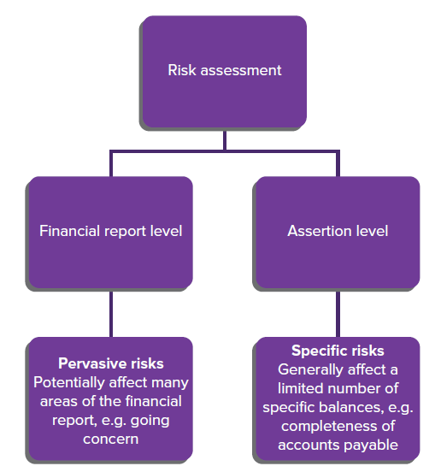
Levels of risk assessment
Source: Grant, G. & Simnett, R. (2018). Auditing & Assurance Services In Australia (7th Ed), Sydney, Australia: McGraw Hill

Slide 6
IR at the financial report level and Business risk (BR)
An entity’s business strategy and associated risks will affect an auditor’s assessment of IR at the financial report level.
Where possible, an auditor traces BRs to areas of a financial report that are likely to be misstated.

Slide 7
Factors affecting IR at financial report level
Integrity of management
Management experience, knowledge and changes during the period
Unusual pressure on management
Nature of the entity’s business
Factors affecting the industry in which the entity operates

Slide 8
Inherent risk and information technology (IT)
  As IT risks can be pervasive to the entity, factors affecting overall IR associated with IT include:
                significant changes in IT
                iinsufficient IT skills and resources
                lack of entity support and focus
                hhigh dependence on IT
                rreliance on external IT
                rreliability and complexity of IT.

Slide 9
Inherent risk at assertion level
  IR is greater for some assertions and related classes of transactions, account balances and disclosures than for others.
  Auditor will normally focus on:
                accounts likely to require adjustment
                complexity of underlying transactions
                judgment involved in determining account balances
                susceptibility of assets to loss or misappropriation
                occurrence of unusual and complex transactions, particularly at or near year-end
                transactions not subject to ordinary processing.

Slide 10
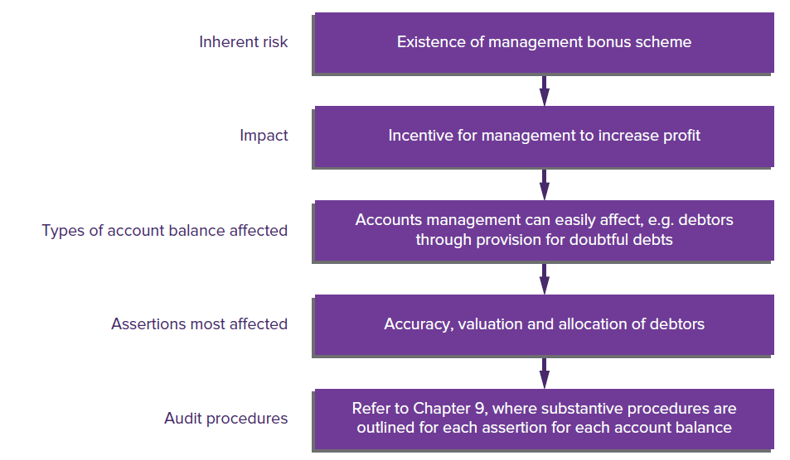
Effect of inherent risk on an account balance assertion
Source: Grant, G. & Simnett, R. (2018). Auditing & Assurance Services In Australia (7th Ed), Sydney, Australia: McGraw Hill

Slide 11
LO 5.2
Fraud

Slide 12
Fraud
  At the planning stage, an auditor must consider the risk that material misstatements resulting from fraud will not be detected, and consider risk of fraud when deciding which risks are significant.
  It is easier to miss material misstatements resulting from fraud because fraud involves acts designed to conceal it, such as collusion, forgery or intentional misrepresentation to the auditor.
  Fraud is defined in ASA 240.12 (ISA 240.12) as:
  ‘An intentional act by one or more individuals among management, those charged with governance, employees, or third parties, involving the use of deception to obtain an unjust or illegal advantage.’

Slide 13
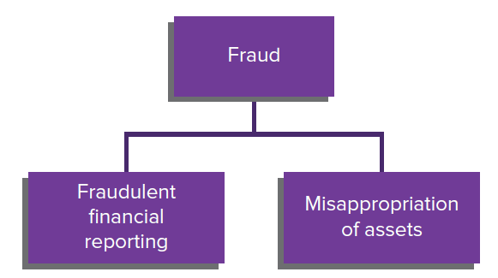
Types of Fraud
Source: Grant, G. & Simnett, R. (2018). Auditing & Assurance Services In Australia (7th Ed), Sydney, Australia: McGraw Hill

Slide 14
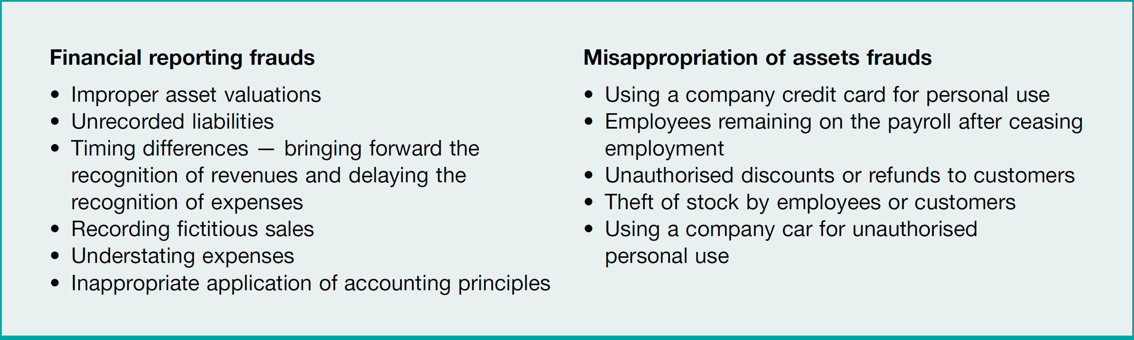
Elements of Fraud
Source: Grant, G. & Simnett, R. (2018). Auditing & Assurance Services In Australia (7th Ed), Sydney, Australia: McGraw Hill

Slide 15
Fraud Risk factors—Red flags
Indicators (red flags) of possible fraud:
                high turnover of key employees
                key finance personnel refusing to take leave
                overly dominant management
                poor compensation practices
                Weak internal controls
                No or ineffective internal audit
                High turnover of auditors
                complex business structure

Slide 16
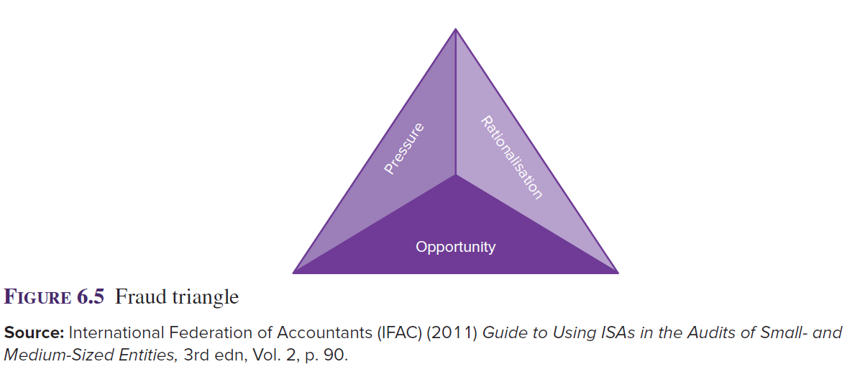
Fraud Triangle
Source: Grant, G. & Simnett, R. (2018). Auditing & Assurance Services In Australia (7th Ed), Sydney, Australia: McGraw Hill

Slide 17
Responsibility for the detection and prevention of fraud
  The primary responsibility for the prevention and detection of fraud rests with those charged with governance of the entity and management (ASA 240.4/ISA 240.4).
  The audit should be planned to obtain reasonable assurance that fraud that may be material has not occurred or, if it has, that the effect of the fraud is properly reflected in the financial report and therefore that the financial report is free from material misstatement due to fraud or error (ASA 240.5/ISA 240.5).
  In planning and conducting the audit, the auditor must exercise reasonable care and skill and maintain an attitude of professional scepticism.
  An auditor will use his or her experience, knowledge and training to determine whether fraud could occur

Slide 18
Responsibility for the detection and prevention of fraud
  Auditors now have to proactively consider fraud. ASA 240/ISA 240 requires auditors to:
    specifically consider risks of material misstatement in a financial report due to fraud
    discuss an entity’s susceptibility to fraud with other members of the audit team
    make more extensive enquiries of management with respect to fraud.

Slide 19
Reporting fraud
        Auditor has a duty to report fraud, irrespective of materiality, to an appropriate level of management when suspicions are aroused.
        Auditors should obtain legal advice if there is any doubt as to the appropriate course of action to take.
        While auditor may be reluctant to report fraud due to the risk of defamation, in most cases auditor is protected from defamation actions by qualified privilege as long as reporting matters in good faith and without malice to people who have a proper interest in receiving the information.

Slide 20
KPMG fraud barometer
        Most common perpetrators of fraud are employees and management (>50% of frauds)
        22% of fraud facilitated through use of technology
        Proportion of frauds perpetrated in groups has doubled, pointing to increased collusion
        40% of frauds took place over longer than 5 years before being discovered.

Slide 21
Earnings Management - CFOs & CEOs
        Earnings management occurs when judgment in financial reporting and in structuring transactions is used to alter financial reports to influence the perceptions of stakeholders.
        Earnings management by clients may fall into
        the following categories:
                intentional violations of accounting standards and other reporting requirements that are individually immaterial
                inappropriate revenue recognition
                ‘big bath’ charges under the guise of restructuring
                improper accruals and estimation of liabilities
                in good times.

Slide 22
LO 5.3
Related parties

Slide 23
Related Parties
        Related parties are defined in AASB 124 (IAS 24) as:
      Entities are related if one entity is able to significantly influence or control the operating, financing or investing decisions of another; or if several entities are subject to control from the same entity; or if the party is a joint venture in which the entity is a venturer.
        Related parties include key management personnel (including directors), their close family members and entities controlled by them as well as superannuation funds run for the benefit of employees or related parties of the entity.
        ASA/ISA 550 requires auditors to specifically assess the risk that related parties and related-party transactions will not be identified, or appropriately disclosed and/or measured.

Slide 24
Identifying the existence of related parties
        Examples of transactions that may indicate the existence of unidentified related parties include transactions that:
                are overly complex (for example, transactions involving multiple parties within a consolidated group)
                have abnormal terms of trade, such as unusual prices, interest rates, repayment terms, or guarantees
                lack an apparent logical business reason to justify their occurrence
                have been processed in an unusual matter.

Slide 25
Procedures for identifying related parties
              Review the previous period’s working papers for known related parties.
              Make enquiries of management concerning the names of all related parties.
              Review the entity’s procedures for identifying related parties.
              Enquire about management’s and directors’ affiliations with other entities.
              Review minutes of meetings.
              Enquire of other auditors involved in audit.

Slide 26
LO 5.4
Appropriateness of the going concern basis

Slide 27
Going concern basis
              Going concern assumption:
              Entity is viewed as continuing in business for the foreseeable future without any intention or necessity to liquidate or otherwise cease its operations (ASA 570.2/ISA 570.2).
              ASA 570.10/ISA 570.10 requires auditors to assess going concern at planning stage, as imminent business failure might affect the appropriateness of presentation of financial report or might motivate management misrepresentations.
              An auditor focuses primarily on anticipated events during the relevant period, approximately 12 months from the date of the current audit report to the expected date of the next audit report.

Slide 28
Going concern assumption
              Going concern justifies valuing assets on basis they will continue to be used in business and liabilities paid when due.
              Remaining a going concern is the responsibility of client governance.
              Auditor must obtain sufficient appropriate evidence to assess validity of going concern assumption.
              Auditor makes professional judgement about going concern risk, based on risk indicators.

Slide 29
Examples of indications of going concern problems
Financial indicators:
              high gearing, fixed-term borrowings nearing maturity, or reliance on short-term borrowings
              withdrawal of financial creditors, inability to pay creditors or denial of trade credit by suppliers
              negative operating cash flows or adverse key financial ratios
              lack of sustainable operating profits
              dividend arrears or discontinuance
              difficulty in complying with terms of loan agreements
              inability to obtain necessary financing.

Slide 30
Examples of indications of going concern problems
Operating indicators:
              management’s intention to cease operations
              loss of key management personnel
              loss of major market, licence or franchise
              prolonged industrial action
              shortages of important supplies
              emergence of highly successful competitors.

Slide 31
Examples of indications of going concern problems
Other indicators:
              non-compliance with capital or statutory requirements
              legal proceedings against the entity
              adverse changes in legislation or government policy
              uninsured or underinsured disasters

Slide 32
Mitigating factors
          Auditor should consider mitigating factors.
          These include:
                Asset factors - sale of assets, or delayed replacement
                Debt factors - unused lines of credit, ability to renew or extend existing loans
                Cost factors - ability to reduce costs

Slide 33
References
Grant, G. & Simnett, R. (2017). Auditing & Assurance Services In Australia (rev: 6th Ed), Sydney, Australia: McGraw Hill
Moroney, R., Campbell, F., & Hamilton, J., (2017). Auditing: A Practical Approach, (3rd ed), Sydney, Australia: Wiley

